Slide 1

Money Honey Financial Services Pvt. Ltd.
Equity Mutual Fund

Slide 2
Table of content
What are equity funds?
Types of equity mutual fund
Why SIP over Lump sum?
Benefits of Equity Fund
Allocation of funds
Role of age
Age wise profiling

Slide 3

What are equity funds?
It is mutual fund invest predominately in equity stocks
An equity mutual fund must invest at least 65% in equities and related instruments.
Equity funds can be divided as per market capitalization.
Gives capital appreciation & have the potential for long term wealth creation.
The choice of scheme depends on investor’s. goal, risk tolerance capacity.

Slide 4
Types of equity mutual fund
Equity mutual fund types
Large Cap Equity Funds
Large & Mid Cap Equity Funds
Mid Cap Mutual Funds
Small Cap Funds
Invests in top 100 Companies of India
Blend of top large cap+ promising mid cap co.
Focuses on Co. range in listed stocks-101st to 250th.
Invests in Beyond 250 Companies, mostly unheard
To be continued

Slide 5
Types of equity mutual fund
Equity mutual fund types
Multi Cap Funds
Flexi Cap Funds
ELSS
Value Oriented
Mandatory to invest 25% of corpus in Small, Mid,
Large cap
Invests in Co. all sizes & across market
Most popular tax saving investments under 80C IT act
Currently dealing in market undervalue, but potential to increase in future

Slide 6
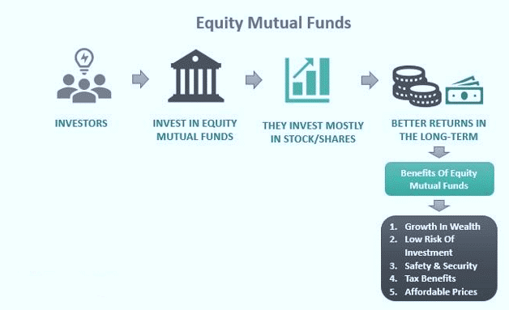
" An investment in knowledge pays the best interest."

Slide 7
Benefits of Equity Fund
Diversification
Invests in various market , sectors so the Share of fund & risk distributes.
Risk mitigation
When one stock or sector under performs, other may pick up, so balances the risk
Wealth creation
They have capacity to offer inflation beating returns to create good corpus
Cost efficient
You invests in various market, sector at a same time with your SIP amount
Compounding power
Re investing the funds enhances the invested capital.
Liqidity
They are flexible & liquidate, not like term deposits
Professional management
Managed by analyst who analyzes stocks & market to get optimum result to investors.
Regulated by SEBI
AUM has to reveal asset allocation information to its investors.
Tax effieinct
Schemes like ELSS specially designed for tax exemption purpose

Slide 8
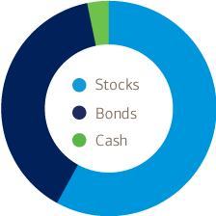
Allocation of funds
Set aside enough money in cash to handle emergencies & near term goals.
Subtract your nearby age from 100, example if you are in your 20’s then 80% in stocks & 20% in Bonds.
The younger and more affluent you are, the higher the percentage.
Diversify Within Investment Categories.

Slide 9


Role of age
“The Wise Man Once Said Invest Young”
No of years invested 35 Yrs
Assumed Rate of Return 15%
Monthly investment 2000
Total investment value at
the age of 60 Rs.2.93 CR
No of years invested 30 yrs
Assumed Rate of Return 15%
Monthly investment 2000
Total investment value at
the age of 60 Rs.1.39 CR
Mr. X
Age 25 YRS
Mr. Y
Age 30 YRS

Slide 10
How to become crorepati !!
If your age is 23 Yrs and invested money into highly rated large-mid cap fund, if you are risk appetite.
Assuming an annual return of 12 per cent, you should invest Rs 15,434 every month to create Rs 2 crore after 22 years.
You should invest Rs 23,150 every month to create Rs 3 crore in 22 years.

Slide 11
Age wise profiling
In 20’s
Goal:
Higher education/vehicle
Profile:
Early in the career
Risk Capacity:
Very High
Asset Allocation:
Equity-80%
Debt -20%

Slide 12
Age wise profiling
In 30’s
Goal:
Marriage / Buying house / Child plan
Profile:
Career on focus
Risk Capacity:
High
Asset Allocation:
Equity-70%
Debt -30%

Slide 13
Age wise profiling
In 40’s
Goal:
Financially dependents & Retirement planning
Profile:
Family responsibilities on focus
Risk Capacity:
Moderate
Asset Allocation:
Equity-60%
Debt -40%

Slide 14
Age wise profiling
In 50’s
Goal:
Robust financial plan to sustain the desired lifestyle
Profile:
Approaching retirement or retired
Risk Capacity:
Low
Asset Allocation:
Equity-20% to nill
Debt -80% to full

Slide 15
Why SIP over Lump sum?
What is Lump sum investment?
One time investment in particular scheme for specific time.
It’s suitable when investor has idle cash /fund with him.

Slide 16
Why SIP over Lump sum?
Disadvantages of lump sum investment
It can be risky if invest a significant corpus at once.
It’s not suitable for everyone, as people don’t keep huge funds with them.
It can discourage confidence of people who want to start with small amount.
No benefit of rupee cost averaging.

Slide 17
Why SIP over Lump sum?
What is SIP investment?
It’s systematic investment plan
Helps investors to invest with small amount
Suitable for each income group people.
It’s flexible, instructs bank to deduct particular amount.

Slide 18
Why SIP over Lump sum?
Advantages of SIP
Investment starts with small amount, as per investor’s capacity.
Reduces burden to have lump sum amount for investment.
Enjoying power of compounding, when returns on investments starts earning too.
You don’t need to worry about timing of market when invest through a SIP.
SIP can be done on daily,
Weekly, monthly, half-yearly tenure.

Slide 19


Slide 20


Slide 21


Thank You

